Slide 1
Welcome to
.NET Conf 2025

Slide 2
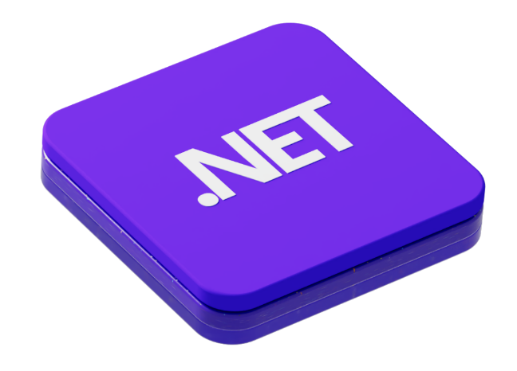









Build any app with the tools and libraries you love
Cloud
Agent
Web
Mobile
Desktop
Games
Runtime
IoT
Languages
Standard libraries
App frameworks
mac
OS
Azure
NuGet
Aspire
Visual Studio
Visual Studio Code
GitHub Copilot
GitHub
Windows
Linux
macOS

Slide 3
.NET ecosystem momentum
7+ Million
Monthly active users
290K+
Pull requests merged to .NET
68K+
Contributors to .NET
Top 5
Highest velocity OSS project
Top 5
Programming language on GitHub
https://github.blog/news-insights/octoverse/octoverse-2024/#the-most-popular-programming-languages
https://github.com/cncf/velocity/blob/main/reports/top_projects_by_activity.txt

Slide 4





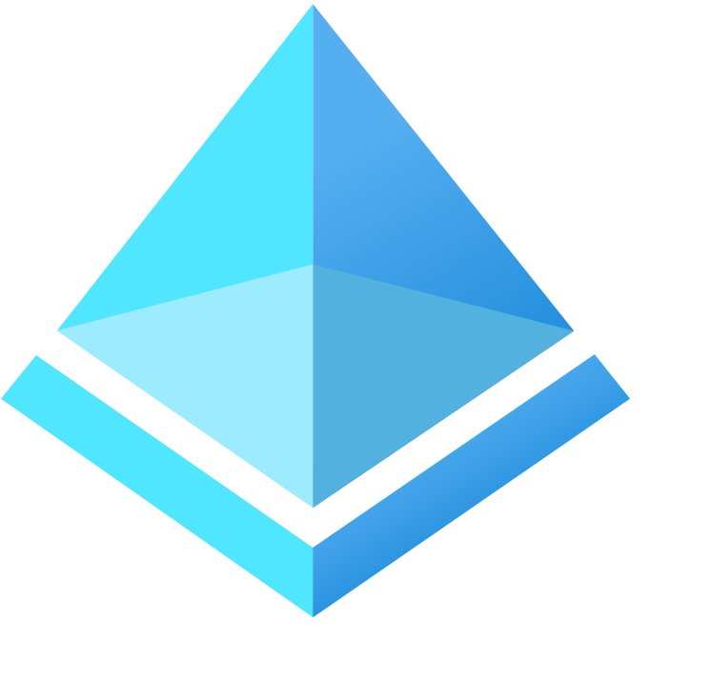









.NET powers Microsoft at scale
aka.ms/dotnet-developer-stories

Slide 5
































Slide 6

RELEASED
Announcing .NET 10
get.dot.net/10
Faster, more elegant, and extensible code with C# 14
Industry leading performance with improvements to help apps launch quicker, run smoother, and scale effortlessly
Supercharged SDK and libraries let you build more secure and future-ready apps with confidence
Modern features for web, cloud, mobile, and cross-platform development designed for today and tomorrow’s workloads
Long-Term Support (LTS) release

Slide 7
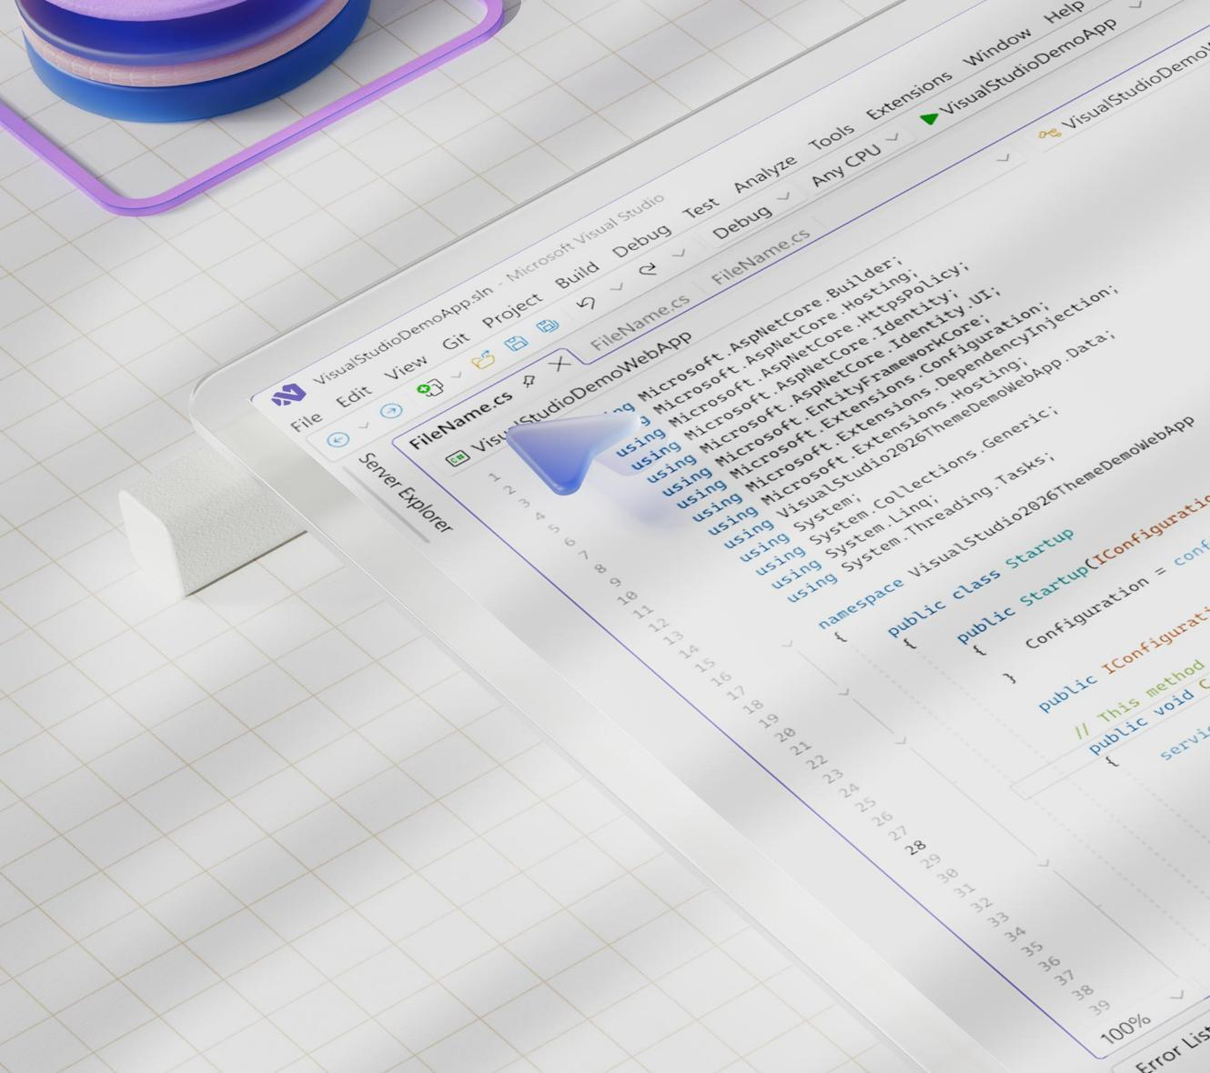
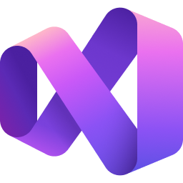
RELEASED
Visual Studio 2026
Visualstudio.com/download
Optimized for .NET 10 and C++, and ready to grow with you with monthly feature updates
Instant startup with solutions loading up to 50% faster and a quicker build, edit, debug cycle even on massive codebases
Modern design with Fluent UI makes it lighter and easier to navigate and stay focused on code, not the tool
AI that works for you with new GitHub Copilot capabilities for profiling, testing, and modernization

Slide 8









Partner contributions to .NET 10
Distro maintainer
and security group partner
Contributed
Android 16 support
Enhancing AI numerical computing through low-level hardware intrinsics
Over 60%
Distro maintainer
and security group partner
Expanding codegen with APX and adding
hardware intrinsics
ISA bring-up and optimization (RISC-V, Arm)
Distro maintainer and security group partner
of community PRs merged to .NET MAUI repo

Slide 9
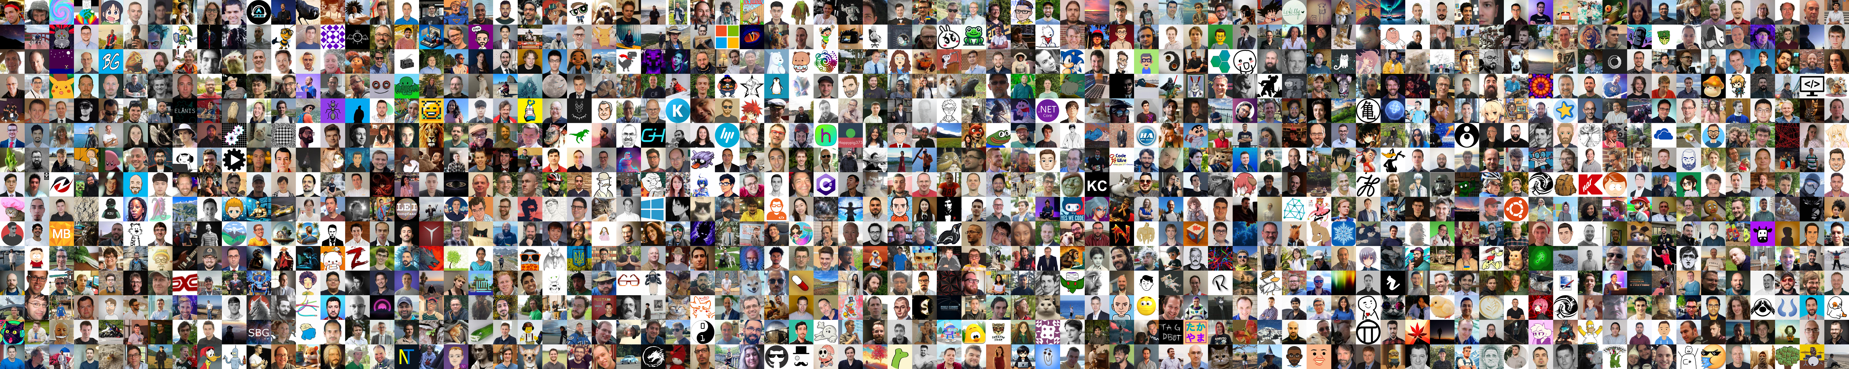
THANK YOU!

Slide 10
.NET minimal APIs performance
TechEmpower Benchmarks
Intel Gold, 56 logical cores (Linux)
15% faster
93% less memory
.NET 8
.NET 10
.NET 8
.NET 10
Source: aka.ms/aspnet/benchmarks

Slide 11








.NET 10
Secure, fast, future-ready
Runtime
.NET SDK
.NET Libraries
Security
Performance improvements, Just-In-Time (JIT) compiler optimizations, improved Garbage Collector (GC), AVX10.2 support for cutting –edge Intel silicon
File-based apps with publish support & native AOT, natively create container images, Microsoft.Testing.Platform support in dotnet test, tab-completion scripts for popular shells
MEAI enhancements, first-class support for MCP, new APIs in cryptography, globalization, numerics, serialization, collections, diagnostics, new JSON serialization options, networking enhancements
Security & cryptography enhancements, including Windows Cryptography API: Next Generation (CNG) support for Post-quantum Cryptography (PQC)
ASP.NET Core
Blazor
.NET MAUI
EF Core
Simple security with WebAuthN & passkeys, validation for Minimal APIs, OpenAPI 3.1, enhanced app observability & diagnostics, smarter memory management, and improved JSON Patch handling
Improved scalability & reliability with declarative state persistence, complex form validation, QuickGrid enhancements, WebAssembly diagnostics, streamlined JavaScript interop, automated browser testing
Editing, build & runtime performance, Aspire integration, many control enhancements and quality improvements, support for latest platform versions including Xcode 26, Android API 35 & 36
LINQ enhancements, performance optimizations, improved support for Azure Cosmos DB, and named query filters

Slide 12
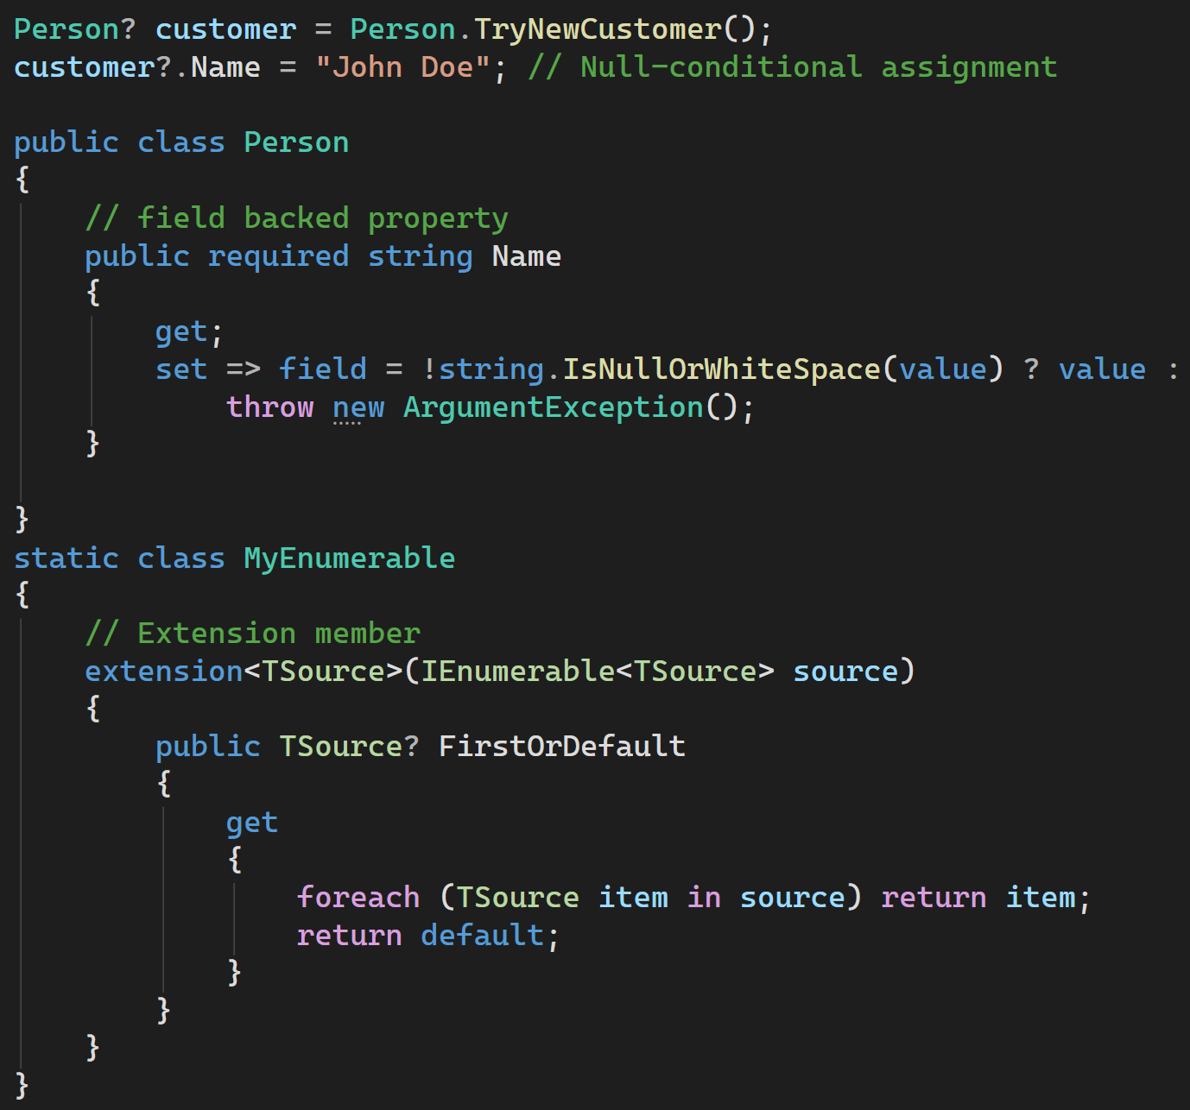
C# 14
Faster, extensible, elegant
Null-conditional assignment
field backed properties
Extension members
Modifiers on simple lambda parameters
nameof supports unbound generic types
Implicit conversions for Span<T> and ReadOnlySpan<T>
Partial events and constructors
User defined compound assignment operators

Slide 13
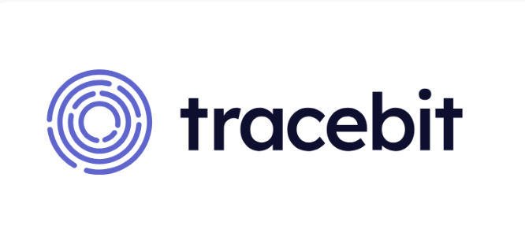
C# has allowed us to be highly productive from the earliest days, and it’s a really solid foundation to build on.”
Sam Cox, Co-Founder & CTO
Tracebit
tracebit.com/blog/why-tracebit-is-written-in-c-sharp

Slide 14




Aspire
Code-first, extensible, observable
Aspire AppHost + CLI
Frontend
Vite dev server
Define your stack in code — type-safe, readable, and debuggable. Aspire runs it all locally, then shifts to real cloud services.
Ordering API
ASP.NET
Aspire Integrations
Plug in any code or service, whether it's local or remote. Aspire brings common patterns – but can model anything.
Auth API
Staging env
Aspire Dashboard
Serverless
Local container
See your entire stack running in one place – all your logs, endpoints, environment variables, even full OpenTelemetry.

Slide 15
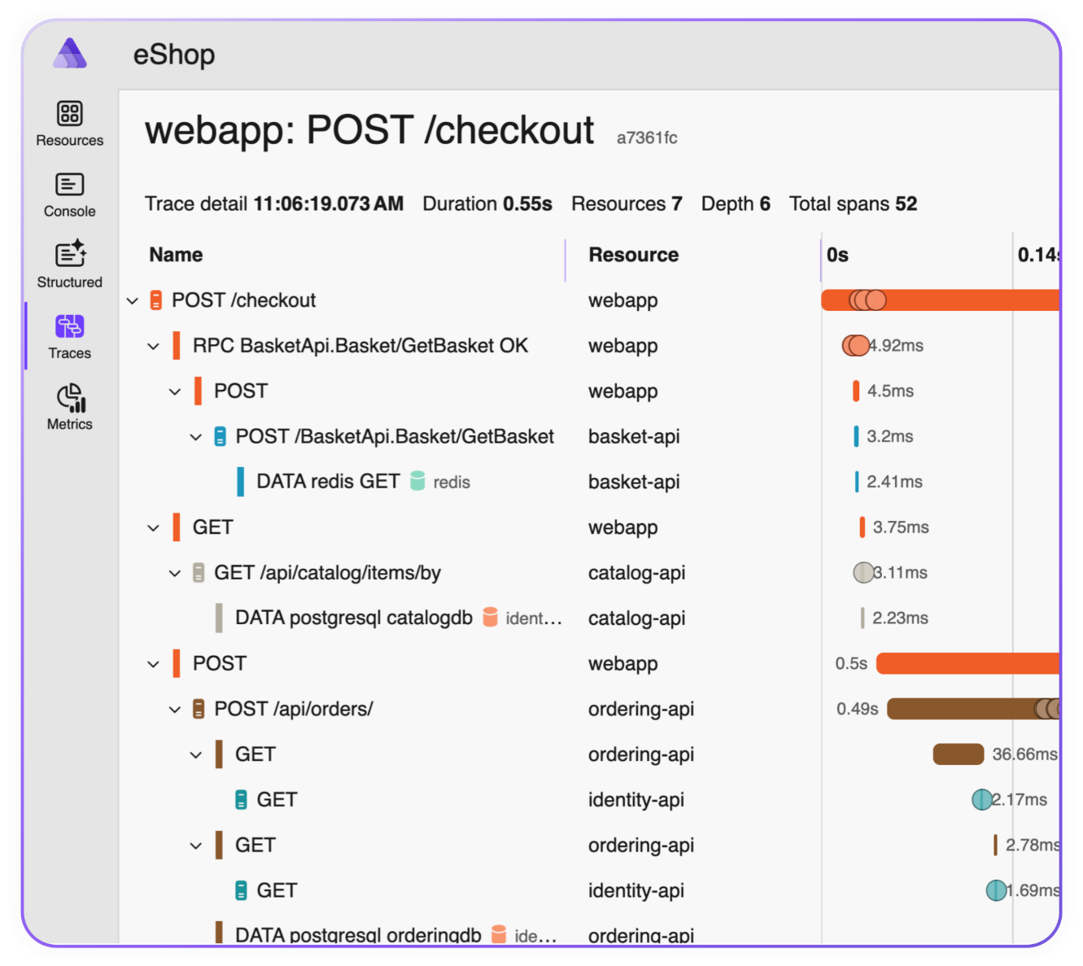
RELEASED
Aspire 13.0
Aspire.dev
Unified infrastructure across .NET​, JavaScript, and Python with debugging, container-deployment, auto-generated Dockerfiles
Modern development experience with CLI enhancements, single-file AppHost support, and quicker onboarding​
Seamless build & deployment, built in static file site support, and robust deploy parallelization​
Enterprise-ready infrastructure & services with flexible connection strings and certificate trust across languages and containers

Slide 16

With Aspire most of what we need is available out of the box and is easily extendable to meet any additional bespoke requirements.“
Andrew Johnston, Principal Developer
Trayport

Slide 17

DEMO
Aspire to .NET 10

Slide 18





.NET app modernization
Challenges of modernizing apps
Dependency conflicts
Deprecated APIs
Takes too long to refactor
Identifying dependencies and researching alternatives can be a guessing game and cause significant re-architecture.
Learning what APIs are deprecated and how to update them is not always immediately clear and can introduce bugs.
Planning and executing an upgrade can take too long and it’s hard to prove clear business value or ROI.
Benefits of modernizing apps
Reduced security risks
Better performance and scale
Modern APIs, tools, architectures
Mitigate and reduce security risks by staying up to date with security patches in runtime and libraries.
Access a cross‑platform runtime that delivers order‑of‑magnitude performance gains through a decade of performance investments.
Access modern APIs, improved tooling and take advantage of cloud-native architectures for automated scaling, monitoring, and secure identity management.

Slide 19
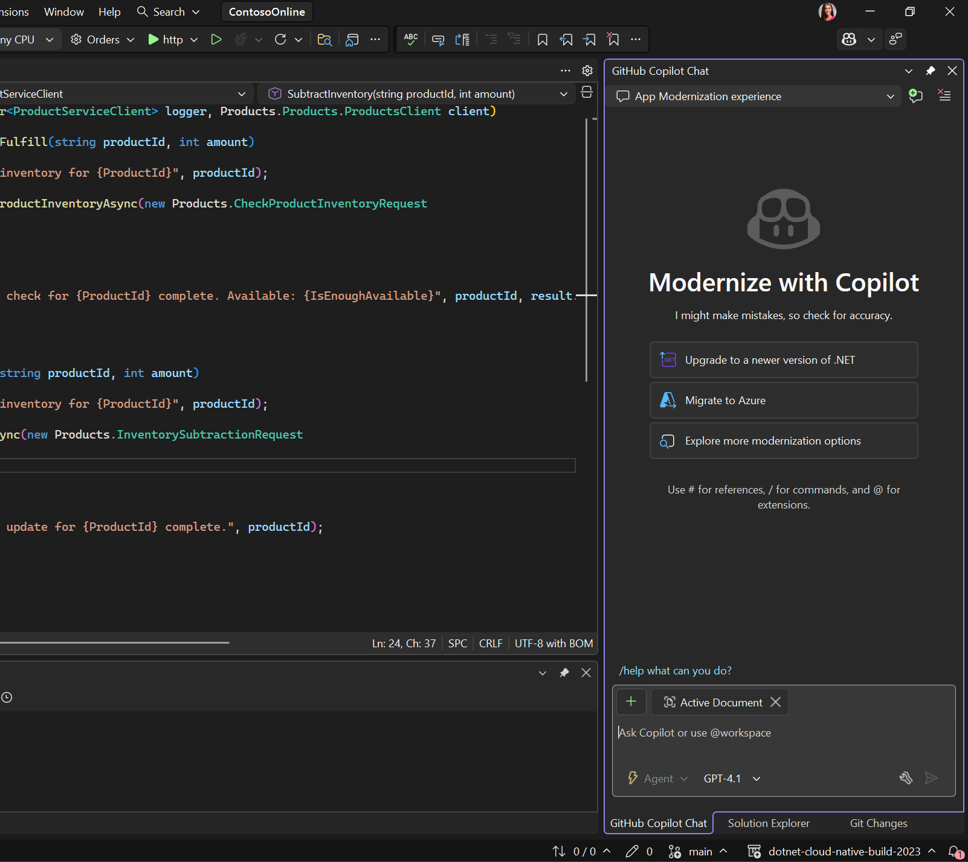
RELEASED
GitHub Copilot app modernization
Available in Visual Studio 2026
Quickly upgrade .NET versions and associated frameworks with AI agents to increase app performance
Perform end-to-end code assessment and remediation for apps to migrate to Azure
Use AI agents to automatically make code changes for moving to Azure app platform services

Slide 20

Once installed, it just worked — upgrading more than a dozen applications seamlessly in just a matter of hours. That speaks volumes.”
Jordan, Staff Platform Engineer
FMG

Slide 21
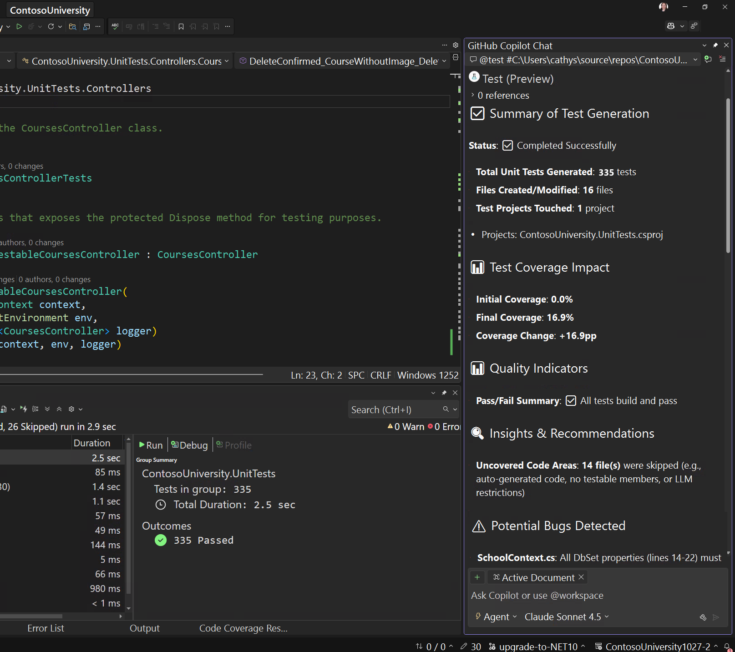
Public Preview
GitHub Copilot testing for .NET
Available in Visual Studio 2026 Insiders
Automate repetitive testing tasks and turn unit testing into a productivity boost
Create and run tests without slowing your flow, so you can ship faster with fewer bugs
Tests are deterministic and reliable, built on the proven C# compiler and language for predictable, high-quality results

Slide 22

DEMO
Modernize to .NET 10

Slide 23

Build intelligent apps, intelligently
Agentic Apps
Agentic DevOps
AI-powered agents infused into your .NET apps
AI-powered agents operating as a member of your dev team
Aspire
Cloud
Web
Build, test, and deploy seamlessly from code to cloud
Visual Studio
Visual Studio Code
Desktop
Mobile
GitHub
Azure
Games
IoT
Applications
Tools

Slide 24
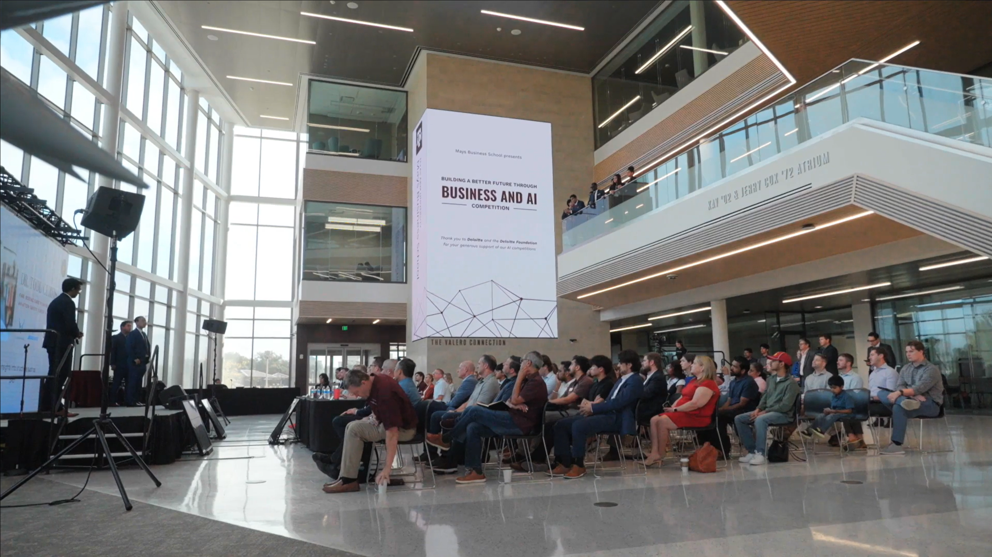


Making the impossible possible with AI

Slide 25







What is an agent?
Agent
LLM
LLM
Input
Output
Instructions
Instructions
Tools
System events
User messages
Agent messages
Tools
Agent messages
Tool results
Tool calls
Retrieval
Actions
Memory

Slide 26



Microsoft Agent Framework
Reliability, flexibility, developer-friendly API
Semantic Kernel
Microsoft Agent Framework
AutoGen
Microsoft.Extensions.AI

Slide 27
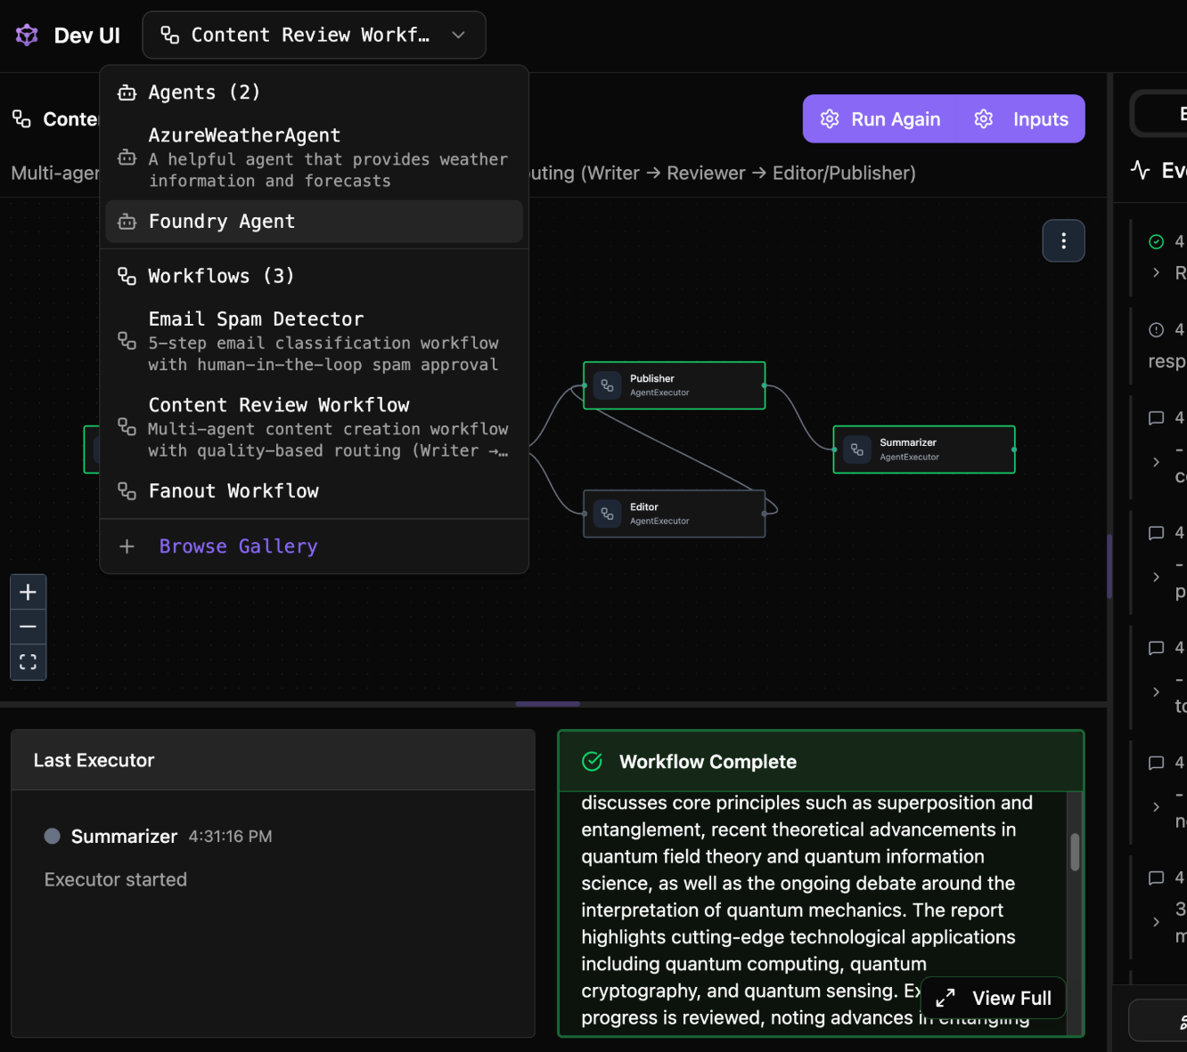
Public Preview
Microsoft Agent Framework
aka.ms/AgentFramework
Unified foundation for building AI agents and multi-agent workflows
Interactive developer UI for agent development, testing, and debugging workflows
Built on open standards for interoperability and flexibility
Community-driven, open-source and extensible by design

Slide 28



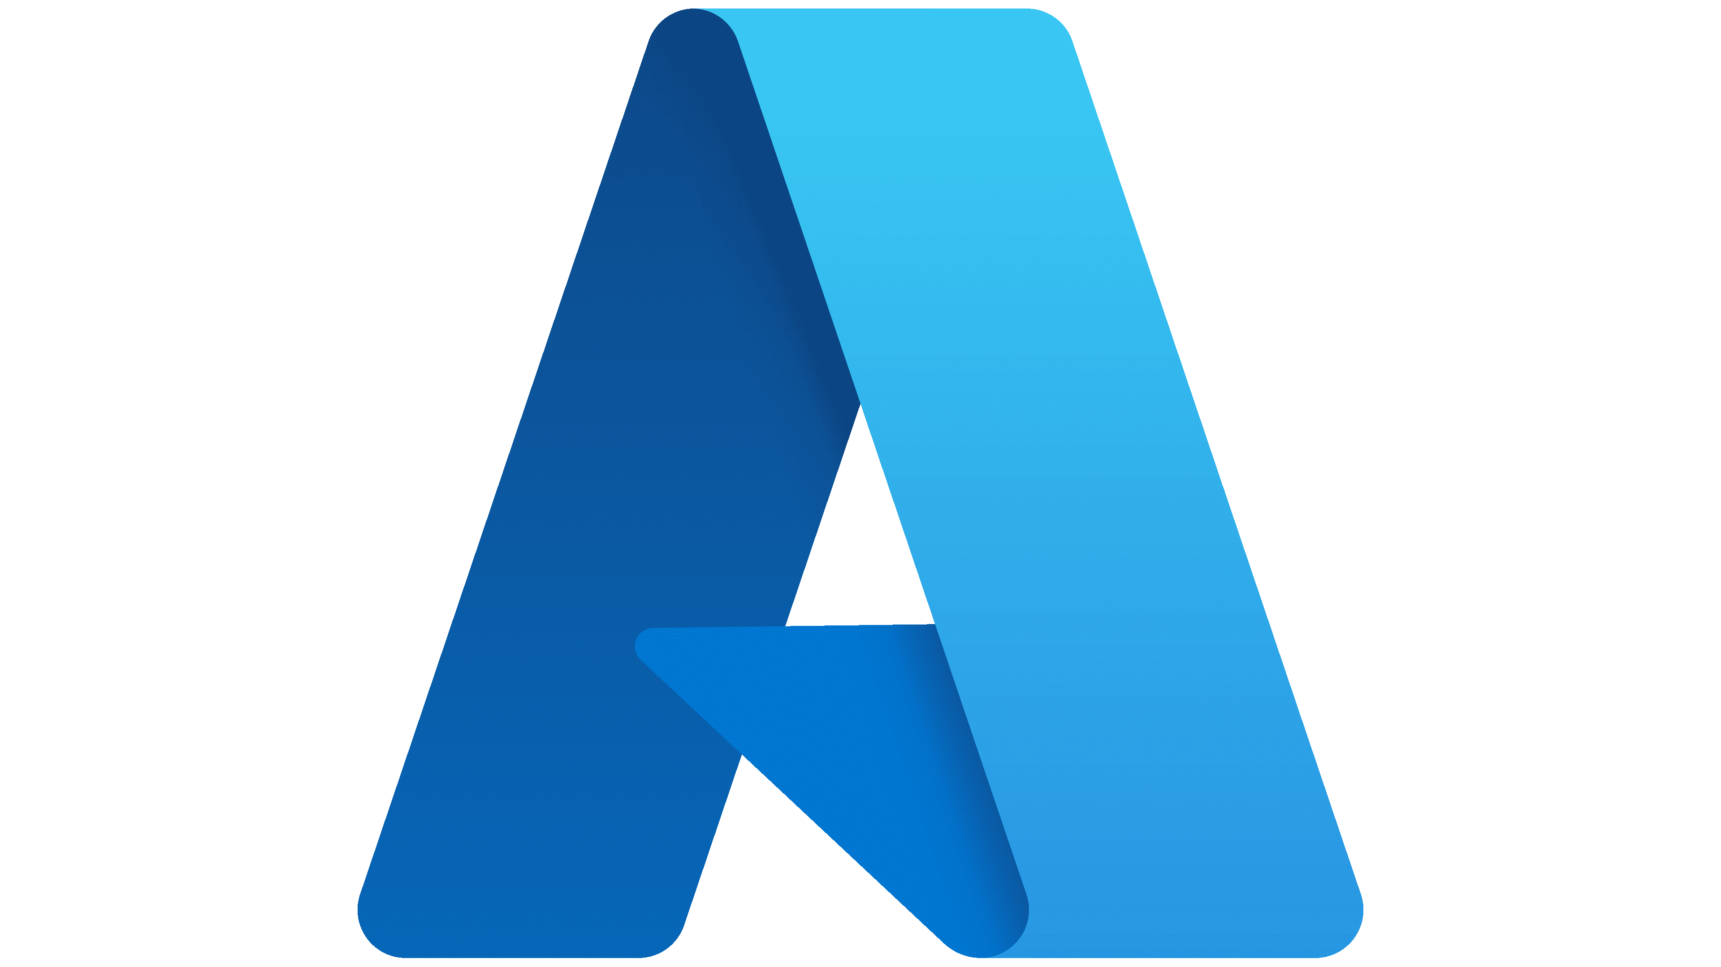


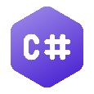
Model Context Protocol (MCP)
MCP Clients
Call tools
Request resources
Get prompts
MCP Servers
Expose tools
Expose resources
Expose prompts
Examples
Your agentic app
Your MCP server
Microsoft Agent Framework
MCP C# SDK

Slide 29
An agent enhanced by MCP
Agent
LLM
LLM
Input
Output
Instructions
Instructions
Tools
System events
User messages
Agent messages
Tools
Agent messages
Tool results
Your MCP server
MCP C# SDK

Slide 30

Public Preview
MCP C# SDK
aka.ms/mcp-cs-sdk
Full support for current MCP spec
Tools, resources, prompts
Elicitation, sampling
Stdio and HTTP transports
Widely used across Microsoft
More features accepted and coming soon

Slide 31

DEMO
Intelligence with .NET 10

Slide 32





.NET Conf 2025
Discover what’s in store this week
.NET
Visual Studio
Azure
Learn all about the new release and the best version of .NET yet, .NET 10!
Learn what’s new in ASP.NET Core, C# 14, Blazor, .NET MAUI, Windows Development and Aspire. Dive deep into performance improvements and learn how to build intelligent, agentic apps all with .NET.
Visual Studio 2026 is faster, smarter, and packed with AI-powered tools to boost your productivity.
From Copilot-assisted debugging to intelligent test generation, see how you are getting supercharged workflows. Dive into real-world profiling, diagnostics, CI automation and more.
Discover how Azure is revolutionizing cloud-native development with .NET.
Explore the latest innovations in Azure services designed specifically for .NET developers. Learn how to build, deploy, scale intelligent, cloud-native applications that leverage the full power of Azure.
🎉 Code Party
🌍 Local Events
Come join our Code Party later today to play games and win awesome prizes!
Connect with your local community at a .NET Conf event in your area.
📢 Community Day
✏️ Student Zone
November 13 is our community day with speakers from around the world. Watch over 40 jam-packed sessions from real-world experts on a variety of .NET topics. From AI-enhanced developer tools and MCP server creation to Blazor migrations, MAUI tips & tricks, retro C# coding on a Commodore 64, plus a whole lot more.
November 14 is the .NET Conf Student Zone, a beginner-friendly virtual event where experts teach you how to build amazing projects - all using C# and .NET! Join us to learn more about AI, web development, mobile development, and game development!

Slide 33
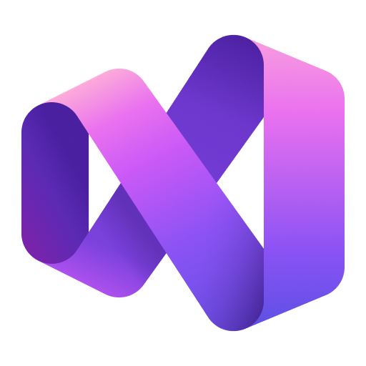
Thank you

